Slide 1
Multiple Regression
Analysis: Estimation

Slide 2


Multiple Regression
Analysis: Estimation
Definition of the multiple linear regression model
“Explains variable in terms of variables ”
Intercept
Slope parameters
Dependent variable,
explained variable,
response variable,…
Error term,
disturbance,
unobservables,…
Independent variables,
explanatory variables,
regressors,…

Slide 3
Multiple Regression
Analysis: Estimation
Motivation for multiple regression
  Incorporate more explanatory factors into the model
  Explicitly hold fixed other factors that otherwise would be in
  Allow for more flexible functional forms
Example: Wage equation
Now measures effect of education explicitly holding experience fixed
All other factors…
Hourly wage
Years of education
Years of labor market experience

Slide 4
Multiple Regression
Analysis: Estimation
Example: Average test scores and per student spending
  Per student spending is likely to be correlated with average family income at a given high school because of school financing
  Omitting average family income in regression would lead to biased estimate of the effect of spending on average test scores
  In a simple regression model, effect of per student spending would partly include the effect of family income on test scores
Other factors
Average standardized
test score of school
Per student spending
at this school
Average family income
of students at this school

Slide 5

Multiple Regression
Analysis: Estimation
Example: Family income and family consumption
  Model has two explanatory variables: inome and income squared
  Consumption is explained as a quadratic function of income
  One has to be very careful when interpreting the coefficients:
Other factors
Family consumption
Family income
Family income squared
By how much does consumption
increase if income is increased
by one unit?
Depends on how much income is already there

Slide 6
Multiple Regression
Analysis: Estimation
Example: CEO salary, sales, and CEO tenure
  Model assumes a constant elasticity relationship between CEO salary and the sales of his or her firm
  Model assumes a quadratic relationship between CEO salary and his or her tenure with the firm
Meaning of “linear” regression
  The model has to be linear in the parameters (not in the variables)
Log of CEO salary
Log sales
Quadratic function of CEO tenure with the firm

Slide 7

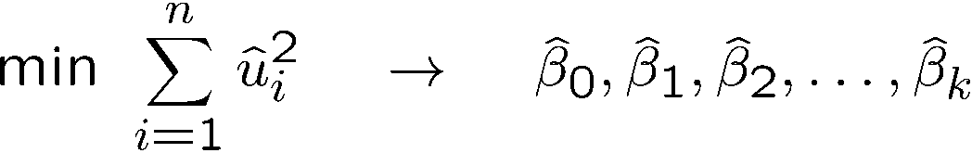
Multiple Regression
Analysis: Estimation
OLS Estimation of the multiple regression model
Random sample
Regression residuals
Minimize sum of squared residuals
Minimization will be carried out by computer

Slide 8
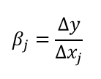
Multiple Regression
Analysis: Estimation
Interpretation of the multiple regression model
  The multiple linear regression model manages to hold the values of other explanatory variables fixed even if, in reality, they are correlated with the explanatory variable under consideration
  “Ceteris paribus”-interpretation
  It has still to be assumed that unobserved factors do not change if the explanatory variables are changed
By how much does the dependent variable change if the j-th
independent variable is increased by one unit, holding all
other independent variables and the error term constant

Slide 9
Multiple Regression
Analysis: Estimation
Example: Determinants of college GPA
Interpretation
  Holding ACT fixed, another point on high school grade point average is associated with another .453 points college grade point average
  Or: If we compare two students with the same ACT, but the hsGPA of student A is one point higher, we predict student A to have a colGPA that is .453 higher than that of student B
  Holding high school grade point average fixed, another 10 points on ACT are associated with less than one point on college GPA
Grade point average at college
High school grade point average
Achievement test score

Slide 10

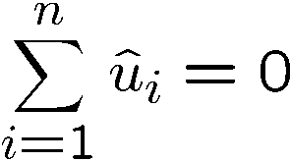
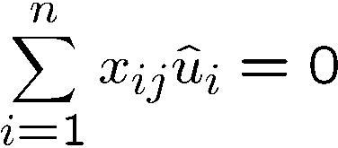
Multiple Regression
Analysis: Estimation
Properties of OLS on any sample of data
Fitted values and residuals
Algebraic properties of OLS regression
Fitted or predicted values
Residuals
Deviations from regression line sum up to zero
Covariance between deviations and regressors are zero
Sample averages of y and of the regressors lie on regression line

Slide 11

Multiple Regression
Analysis: Estimation
“Partialling out” interpretation of multiple regression
One can show that the estimated coefficient of an explanatory variable in a multiple regression can be obtained in two steps:
  1) Regress the explanatory variable on all other explanatory variables
  2) Regress on the residuals from this regression
Why does this procedure work?
  The residuals from the first regression is the part of the explanatory variable that is uncorrelated with the other explanatory variables
  The slope coefficient of the second regression therefore represents the isolated effect of the explanatory variable on the dep. variable

Slide 12
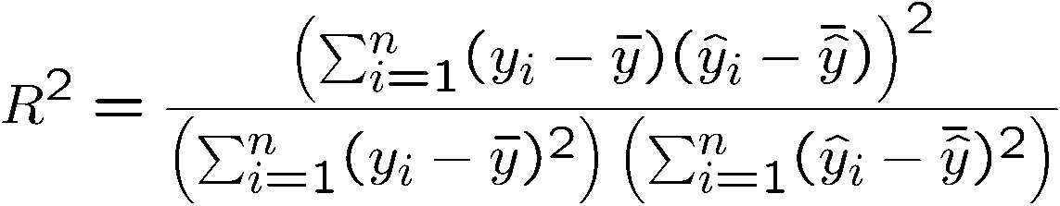
Multiple Regression
Analysis: Estimation
Goodness-of-Fit
Decomposition of total variation
R-squared
Alternative expression for R-squared
Notice that R-squared can only
increase if another explanatory
variable is added to the regression
R-squared is equal to the squared
correlation coefficient between the
actual and the predicted value of
the dependent variable

Slide 13
Multiple Regression
Analysis: Estimation
Example: Explaining arrest records
Interpretation:
  If the proportion prior arrests increases by 0.5, the predicted fall in arrests is 7.5 arrests per 100 men
  If the months in prison increase from 0 to 12, the predicted fall in arrests is 0.408 arrests for a particular man
  If the quarters employed increase by 1, the predicted fall in arrests is 10.4 arrests per 100 men
Number of times
arrested 1986
Proportion prior arrests
that led to conviction
Months in prison 1986
Quarters employed 1986

Slide 14
Multiple Regression
Analysis: Estimation
Example: Explaining arrest records (cont.)
  An additional explanatory variable is added:
Interpretation:
  Average prior sentence increases number of arrests (?)
  Limited additional explanatory power as R-squared increases by little
General remark on R-squared
  Even if R-squared is small (as in the given example), regression may still provide good estimates of ceteris paribus effects
Average sentence in prior convictions
R-squared increases only slightly

Slide 15

Multiple Regression
Analysis: Estimation
Standard assumptions for the multiple regression model
Assumption MLR.1 (Linear in parameters)
Assumption MLR.2 (Random sampling)
The data is a random sample
drawn from the population
Each data point therefore follows the population equation

Slide 16
Multiple Regression
Analysis: Estimation
Standard assumptions for the multiple regression model (cont.)
Assumption MLR.3 (No perfect collinearity)
Remarks on MLR.3
  The assumption only rules out perfect collinearity/correlation bet-ween explanatory variables; imperfect correlation is allowed
  If an explanatory variable is a perfect linear combination of other explanatory variables it is superfluous and may be eliminated
  Constant variables are also ruled out (collinear with intercept)
“In the sample (and therefore in the population), none
of the independent variables is constant and there are
no exact linear relationships among the independent variables.”

Slide 17
Multiple Regression
Analysis: Estimation
Example for perfect collinearity: small sample
Example for perfect collinearity: relationships between regressors
In a small sample, avginc may accidentally be an exact multiple of expend; it will not
be possible to disentangle their separate effects because there is exact covariation
Either shareA or shareB will have to be dropped from the regression because there
is an exact linear relationship between them: shareA + shareB = 1

Slide 18
Multiple Regression
Analysis: Estimation
Standard assumptions for the multiple regression model (cont.)
Assumption MLR.4 (Zero conditional mean)
  In a multiple regression model, the zero conditional mean assumption is much more likely to hold because fewer things end up in the error
Example: Average test scores
The value of the explanatory variables
must contain no information about the mean of the unobserved factors
If avginc was not included in the regression, it would end up in the error term; it would then be hard to defend that expend is uncorrelated with the error

Slide 19
Multiple Regression
Analysis: Estimation
Discussion of the zero mean conditional assumption
  Explanatory variables that are correlated with the error term are called endogenous; endogeneity is a violation of assumption MLR.4
  Explanatory variables that are uncorrelated with the error term are called exogenous; MLR.4 holds if all explanat. var. are exogenous
  Exogeneity is the key assumption for a causal interpretation of the regression, and for unbiasedness of the OLS estimators
Theorem 3.1 (Unbiasedness of OLS)
  Unbiasedness is an average property in repeated samples; in a given sample, the estimates may still be far away from the true values

Slide 20


Multiple Regression
Analysis: Estimation
Including irrelevant variables in a regression model
Omitting relevant variables: the simple case
No problem because .
= 0 in the population
However, including irrevelant variables may increase sampling variance.
True model (contains x₁ and x₂)
Estimated model (x₂ is omitted)

Slide 21

Multiple Regression
Analysis: Estimation
Omitted variable bias
Conclusion: All estimated coefficients will be biased
If x₁ and x₂ are correlated, assume a linear regression relationship between them
If y is only regressed
on x₁ this will be the estimated intercept
If y is only regressed
on x₁, this will be the estimated slope on x₁
error term

Slide 22


Multiple Regression
Analysis: Estimation
Example: Omitting ability in a wage equation
When is there no omitted variable bias?
  If the omitted variable is irrelevant or uncorrelated
Will both be positive
The return to education will be overestimated because . It will look
as if people with many years of education earn very high wages, but this is partly
due to the fact that people with more education are also more able on average.

Slide 23
Multiple Regression
Analysis: Estimation
Omitted variable bias: more general cases
  No general statements possible about direction of bias
  Analysis as in simple case if one regressor uncorrelated with others
Example: Omitting ability in a wage equation
True model (contains x₁, x₂, and x₃)
Estimated model (x₃ is omitted)
If exper is approximately uncorrelated with educ and abil, then the direction
of the omitted variable bias can be as analyzed in the simple two variable case.

Slide 24


Multiple Regression
Analysis: Estimation
Standard assumptions for the multiple regression model (cont.)
Assumption MLR.5 (Homoskedasticity)
Example: Wage equation
Short hand notation
The value of the explanatory variables
must contain no information about the variance of the unobserved factors
This assumption may also be hard
to justify in many cases
All explanatory variables are collected in a random vector
with

Slide 25
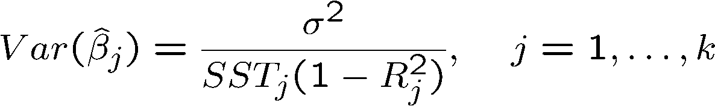
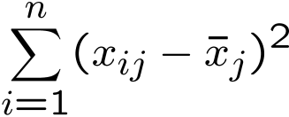
Multiple Regression
Analysis: Estimation
Theorem 3.2 (Sampling variances of the OLS slope estimators)
Under assumptions MLR.1 – MLR.5:
Variance of the error term
Total sample variation in
explanatory variable x_{j}:
R-squared from a regression of explanatory variable x_{j} on all other independent variables
(including a constant)

Slide 26
Multiple Regression
Analysis: Estimation
Components of OLS Variances:
1) The error variance
  A high error variance increases the sampling variance because there is more “noise” in the equation
  A large error variance necessarily makes estimates imprecise
  The error variance does not decrease with sample size
2) The total sample variation in the explanatory variable
  More sample variation leads to more precise estimates
  Total sample variation automatically increases with the sample size
  Increasing the sample size is thus a way to get more precise estimates

Slide 27



Multiple Regression
Analysis: Estimation
3) Linear relationships among the independent variables
  Sampling variance of will be the higher the better explanatory variable can be linearly explained by other independent variables
  The problem of almost linearly dependent explanatory variables is called multicollinearity (i.e. for some )
Regress on all other independent variables (including a constant)
The R-squared of this regression will be the higher
the better x_{j} can be linearly explained by the other independent variables

Slide 28
Multiple Regression
Analysis: Estimation
An example for multicollinearity
Average standardized
test score of school
Expenditures
for teachers
Expenditures for in-
structional materials
Other ex-
penditures
The different expenditure categories will be strongly correlated because if a school has a lot of resources it will spend a lot on everything.
It will be hard to estimate the differential effects of different expenditure categories because all expenditures are either high or low. For precise estimates of the differential effects, one would need information about situations where expenditure categories change differentially.
As a consequence, sampling variance of the estimated effects will be large.

Slide 29
Multiple Regression
Analysis: Estimation
Discussion of the multicollinearity problem
  In the above example, it would probably be better to lump all expen-diture categories together because effects cannot be disentangled
  In other cases, dropping some independent variables may reduce multicollinearity (but this may lead to omitted variable bias)

Slide 30

Multiple Regression
Analysis: Estimation
  Only the sampling variance of the variables involved in multicollinearity will be inflated; the estimates of other effects may be very precise
  Note that multicollinearity is not a violation of MLR.3 in the strict sense
  Multicollinearity may be detected through “variance inflation factors”
As an (arbitrary) rule of thumb, the variance
inflation factor should not be larger than 10

Slide 31

Multiple Regression
Analysis: Estimation
Variances in misspecified models
  The choice of whether to include a particular variable in a regression can be made by analyzing the tradeoff between bias and variance
  It might be the case that the likely omitted variable bias in the misspecified model 2 is overcompensated by a smaller variance
True population model
Estimated model 1
Estimated model 2

Slide 32


Multiple Regression
Analysis: Estimation
Variances in misspecified models (cont.)
Case 1:
Case 2:
Conditional on x₁ and x₂, the variance in model 2 is always smaller than that in model 1
Conclusion: Do not include irrelevant regressors
Trade off bias and variance; Caution: bias will not vanish even in large samples

Slide 33
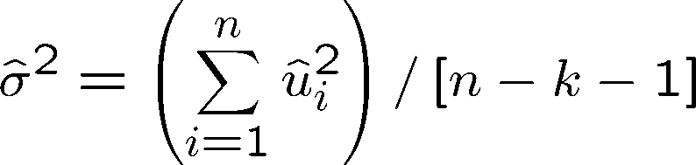
Multiple Regression
Analysis: Estimation
Estimating the error variance
Theorem 3.3 (Unbiased estimator of the error variance)
An unbiased estimate of the error variance can be obtained by substracting the number of estimated regression coefficients from the number of observations. The number of obser-vations minus the number of estimated parameters is also called the degrees of freedom. The n estimated squared residuals in the sum are not completely independent but related
through the k+1 equations that define the first order conditions of the minimization problem.

Slide 34



Multiple Regression
Analysis: Estimation
Estimation of the sampling variances of the OLS estimators
Note that these formulas are only valid under assumptions MLR.1-MLR.5 (in particular, there has to be homoskedasticity)
The true sampling
variation of the
estimated
Plug in for the unknown
The estimated samp-
ling variation of the
estimated

Slide 35
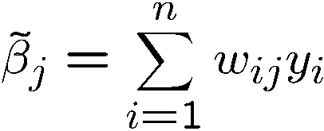
Multiple Regression
Analysis: Estimation
Efficiency of OLS: The Gauss-Markov Theorem
  Under assumptions MLR.1 - MLR.5, OLS is unbiased
  However, under these assumptions there may be many other estimators that are unbiased
  Which one is the unbiased estimator with the smallest variance?
  In order to answer this question one usually limits oneself to linear estimators, i.e. estimators linear in the dependent variable
May be an arbitrary function of the sample values of all the explanatory variables; the OLS estimator
can be shown to be of this form

Slide 36

Multiple Regression
Analysis: Estimation
Theorem 3.4 (Gauss-Markov Theorem)
  Under assumptions MLR.1 - MLR.5, the OLS estimators are the best linear unbiased estimators (BLUEs) of the regression coefficients, i.e.
OLS is only the best estimator if MLR.1 – MLR.5 hold; if there is heteroskedasticity for example, there are better estimators.
for all
for which .

